Slide 1
CENG 477 Introduction to Computer Graphics
Ray Tracing: Shading

Slide 2
Last Week
Until now we learned:
How to create the primary rays from the given camera and image plane parameters
How to intersect these rays with various objects:
Planes
Spheres
Triangles

Slide 3
Algorithm So Far
foreach pixel s:
compute the viewing ray r (from e to s)
t_{min} = ∞, obj = NULL
foreach object o:
if r intersects o:
if t < t_{min}:
t_{min} = t, obj = o
if obj not NULL:
pixel color = color of obj
else
pixel color = color of background

Slide 4

Image So Far
Two spheres with different colors and a gray background
So much work for such a bad image!

Slide 5
Image So Far
Two spheres with different colors and a gray background
So much work for such a bad image!
The image looks bad because we did not use a realistic shading algorithm
We simply set all surface points to the same color

Slide 6
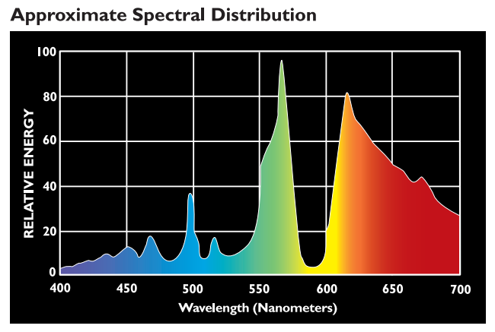

Reflectance and Power
We assumed that each object has a color
This is not how it is in reality
Each object has a reflectance distribution
Each light source has a power distribution
Normally, both are functions of wavelength:
From forums.gardenweb.com
Notes:
A reflectance distribution, more formally known as the Bidirectional Reflectance Distribution Function (BRDF), describes how light is reflected from a surface.
(SPD) of a light source describes the power or energy of the light at each wavelength across the electromagnetic spectrum.

Slide 7
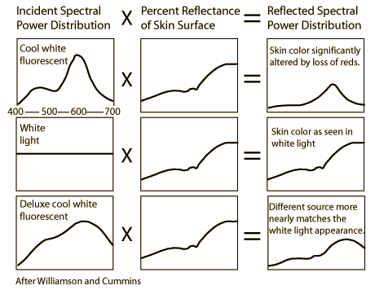
Reflectance and Power
The object color occurs as a result of their interaction
Same object can appear different under different lights

Slide 8
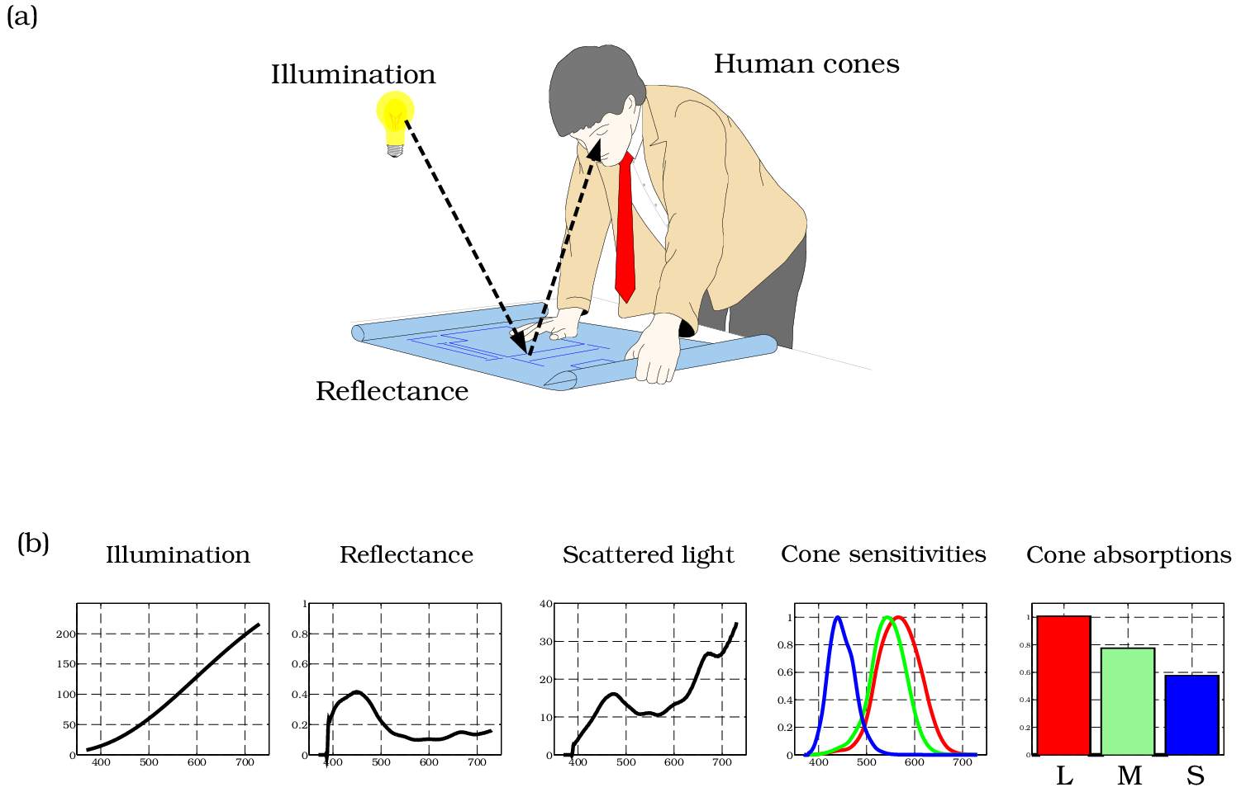
Reflectance, Power, Cones
Color is perceived due to the interaction of this reflected light by our cone pigments
foundationsofvision.stanford.edu

Slide 9
Spectral Ray Tracing
Accurately modeling this process requires us to represent all objects and light sources using spectral (i.e. wavelength-based) distributions
Some ray-tracers do this:
Indigo renderer (http://www.indigorenderer.com/)
Lux renderer (http://www.luxrender.net/)
Mental ray (http://www.nvidia-arc.com/products/nvidia-mental-ray.html)
…

Slide 10
RGB Model
We will make a simplifying assumption and represent all objects and light source with three components
Reflectance:
R_{r}: How much red light it reflects, a value between [0,1]
R_{g}: How much green light it reflects, a value between [0,1]
R_{b}: How much blue light it reflects, a value between [0,1]
Power:
I_{r}: How much red light it emits, a value between [0,∞)
I_{g}: How much green light it emits, a value between [0,∞)
I_{b}: How much blue light it emits, a value between [0,∞)

Slide 11
Terms
The following terms are important when talking about light-surface interaction:
Power
Intensity
Radiance
Irradiance

Slide 12
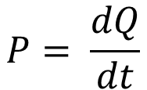
Power
Power is the time-rate of energy
It measures how much energy (i.e. in Joules) a light source emits in all possible directions per second
Power is measured in Watts (W = J/s)
Power (P) is also known as flux (Φ)
Energy
$$P= \frac{dQ}{dt}$$
time

Slide 13
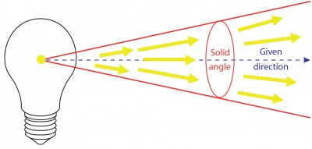
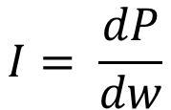
Intensity
Intensity is defined as power per solid angle
Typically defined for point light sources and measured in W/sr
Power
$$I= \frac{dP}{dw}$$
lec-expert.com
Solid angle

Slide 14
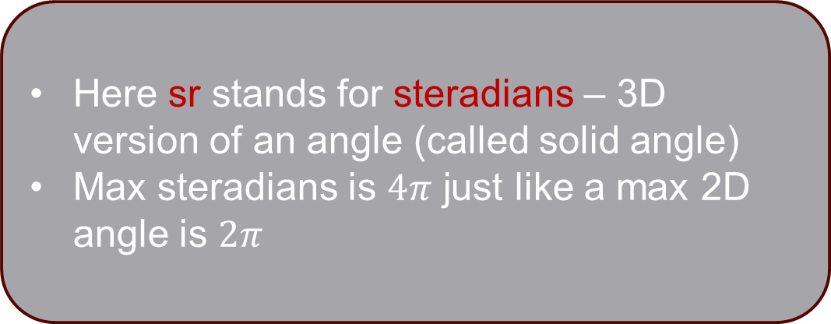
Intensity
Intensity is defined as power per solid angle
Typically defined for point light sources and measured in W/sr
Here sr stands for steradians – 3D version of an angle (called solid angle)
Max steradians is $4π$ just like a max 2D angle is $2π$
Power
$$I= \frac{dP}{dw}$$
lec-expert.com
Solid angle

Slide 15
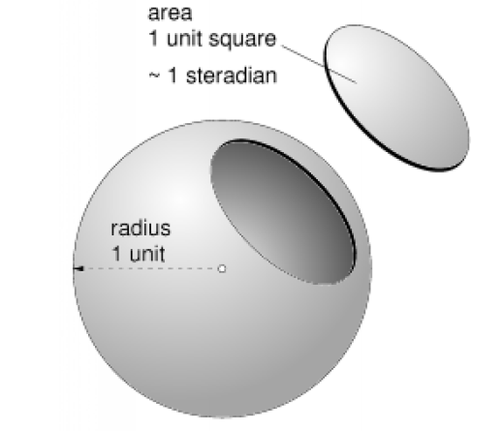
Solid Angle
Solid angle is the 3D generalization of the angle
It corresponds to a surface area on a unit sphere
similar to angle corresponding to a length on a unit circle
measured in steradians

Slide 16
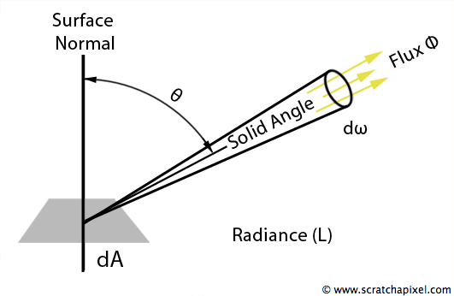
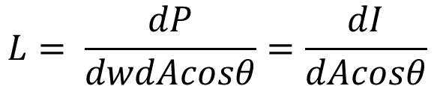
Radiance
Radiance is defined as power per solid angle per projected area
Measured in Watts per steradian per meter squared (W/sr/m²)
Intensity
$$L= \frac{dP}{dwdAcosθ}=\frac{dI}{dAcosθ}$$
Projected area
Notes:
Buradaki area’dan kasıt light source’ın area’sı

Slide 17
Radiance
Radiance is the most important unit in ray tracing
Radiance of a ray does not change as the ray travels in empty space
The Goal of Ray Tracing
Compute the radiance along each viewing ray

Slide 18
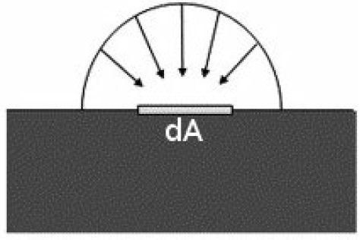
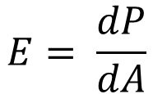
Irradiance
Irradiance measures the total incident power per unit area
Measured in W/m²
Power
$$E= \frac{dP}{dA}$$
Area

Slide 19
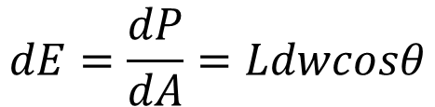
Irradiance from Radiance
Irradiance can be computed from radiance:
L
n
Θ
dw
$$dE=\frac{dP}{dA}=Ldwcosθ$$
dA

Slide 20
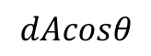
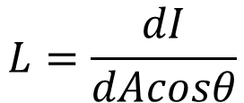
Radiance from Intensity
Finally, radiance can be computed from intensity:
I
L
n
Θ
dw
$$L=\frac{dI}{dAcosθ}$$
dA
$$dAcosθ$$

Slide 21
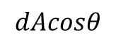
Radiance from Intensity
Now, imagine that dA was further away
The same intensity would be spread over a larger area
This relationship is governed by the inverse square law
I
dw
$$L=\frac{dI}{dAcosθ}$$
n
L
Θ
$$dAcosθ$$
dA

Slide 22
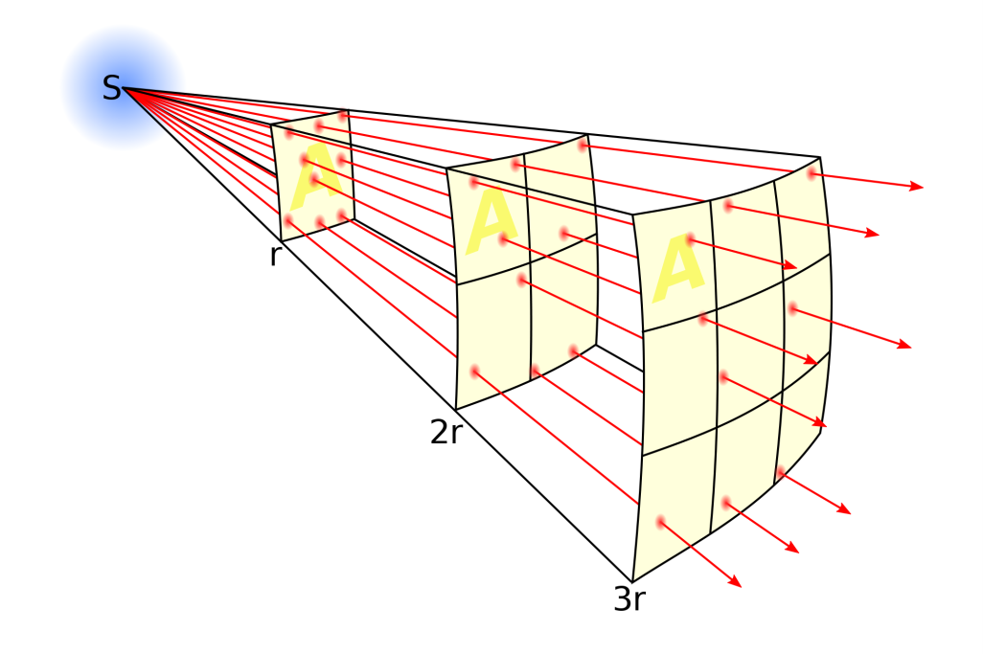
Inverse Square Law
The irradiance emitted by a point light source is reduced by the square of the distance from the source

Slide 23
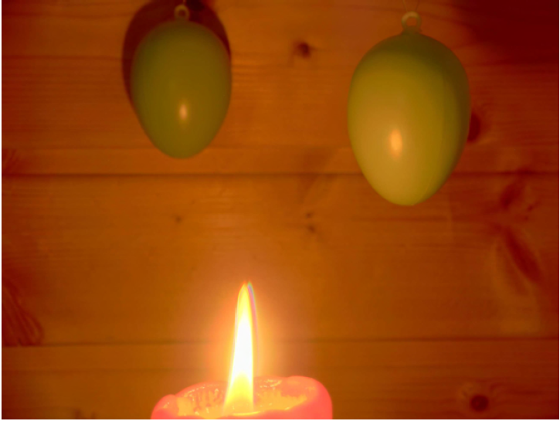
Inverse Square Law
Objects further away from the light source appear dimmer as a result
This is why the distance of the stars can be judged by their brightness

Slide 24
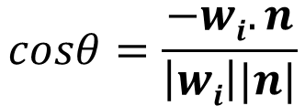
The Cosine Law
The cosine law states that a surface can receive (or emit) radiation only in proportion to its area projected in the direction of the light:
I
$$cosθ=\frac{−wi.n}{\left|wi\right||n|}$$
n
L
w_{i}
Θ
$$dAcosθ$$
dA

Slide 25
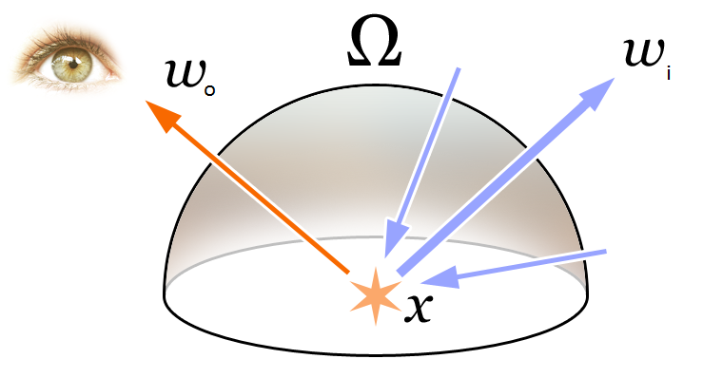
Rendering Equation
Putting together all these concepts gives us an equation known as the rendering equation
It models how much light arriving from an incoming direction (w_{i}) is reflected toward an outgoing direction (w_{o})

Slide 26
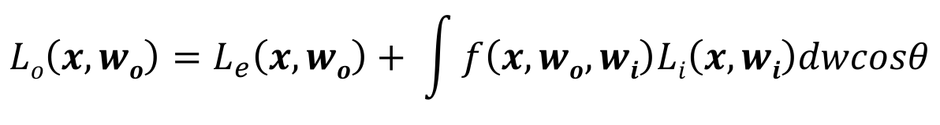
Rendering Equation
Integration over
hemisphere
Perpendicularly
received irradiance
$$Lo\left(x, wo\right)=L_{e}\left(x, wo\right)+ \int{f\left(x, wo, wi\right)Li\left(x, wi\right)dwcosθ}$$
Ω
Outgoing
radiance
Emitted
radiance
Reflectance
Function (BRDF)
Incoming
radiance
Differential
solid angle
Area
correction
factor

Slide 27
Rendering Equation
Too costly to evaluate
For each surface point x we need to integrate over the entire hemisphere surrounding x
Simplification:
Exclude all directions except light sources
Add an ambient term to simulate what was excluded

Slide 28
Surface Normals (Reminder)
A surface normal is a unit vector which is orthogonal to the surface and points outward from the surface
n
n₁
x₁
x₂
x
n₂

Slide 29
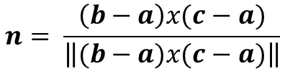
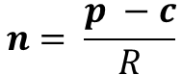
Surface Normals (Reminder)
Depends on the type of the object:
For a plane, surface normal is given so you don’t have to do anything (except to normalize it if it isn’t normalized).
For a sphere, compute:
For a triangle, compute cross product of two edge vectors:
p
n
$$n= \frac{p −c}{R}$$
c
R
c
n
$$n= \frac{\left(b−a\right)x(c−a)}{\left\|(b−a)x(c−a)\right\|}$$
c - a
b - a
a
b

Slide 30
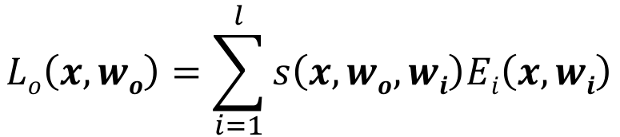
Shading Models
We will approximate the rendering equation as a sum of three simple shading models:
Diffuse shading
Specular shading
Ambient shading
All models are based on a modified rendering equation:
Number of lights
$$Lo\left(x, wo\right)=\sum_{i=1}^{l}{s\left(x, wo, wi\right)Ei\left(x, wi\right)}$$
Perpendicularly
received irradiance
Outgoing
radiance
Surface reflectance

Slide 31
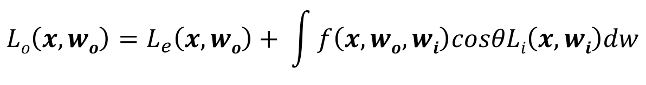
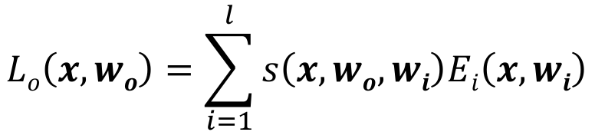
Shading Models
Compare the surface shading equation with the rendering equation
$$Lo\left(x, wo\right)=\sum_{i=1}^{l}{s\left(x, wo, wi\right)Ei\left(x, wi\right)}$$
$$Lo\left(x, wo\right)=L_{e}\left(x, wo\right)+ \int{f\left(x, wo, wi\right)cosθLi\left(x, wi\right)dw}$$
Ω

Slide 32
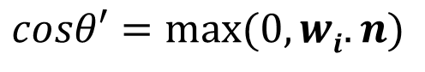
Diffuse Shading
Simulates the phenomenon that a surface can receive radiation only in proportion to its area projected in the direction of the light:
$$L_{o}^{d}(x,wo)=kdcosθ^{′}Ei\left(x, wi\right)$$
w_{i}
n
w_{o}
Θ
Outgoing
radiance
Diffuse
reflectance
coefficient
Perpendicularly
received
irradiance
x
$$cosθ′=max⁡(0, wi.n)$$

Slide 33
Diffuse Shading
Note that a diffuse surface reflects equal radiance in all directions (looks equally bright from all viewing directions)
Such a surface is called a Lambertian surface (1760)
$$L_{o}^{d}(x,wo)=kdcosθ^{′}Ei\left(x, wi\right)$$
w_{i}
n
w_{o}
Θ
Diffuse
reflectance
coefficient
Outgoing
radiance
Received
irradiance
x
$$cosθ′=max⁡(0, wi.n)$$

Slide 34
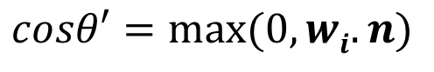
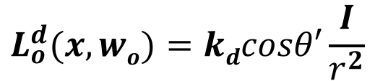
Diffuse Shading
Also, for a point light source, we must compute irradiance at a distance r from the light source: inverse square law
This improves realism
Light intensity
I
$$L_{o}^{d}(x,wo)=kdcosθ′\frac{I}{r^{2}}$$
w_{i}
r
n
w_{o}
Θ
Diffuse
reflectance
coefficient
Outgoing
radiance
x
Light distance
$$cosθ′=max⁡(0, wi.n)$$

Slide 35
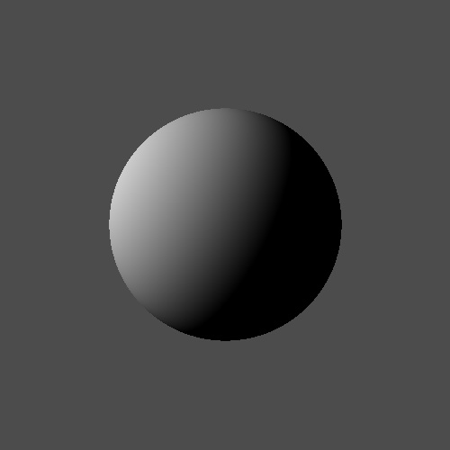
Diffuse Shading Example
A sphere shaded by diffuse shading:
directxtutorial.com

Slide 36
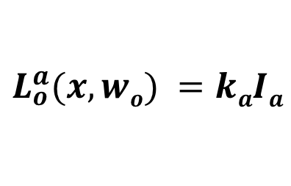
Ambient Shading
With diffuse shading parts of the sphere that do not face the light source are all black
Ambient shading is used as a very crude approximate of the integral in rendering equation:
$$L_{o}^{a}(x,wo) =kaIa$$
Ambient
radiance
Outgoing
radiance
Ambient
reflectance
coefficient

Slide 37
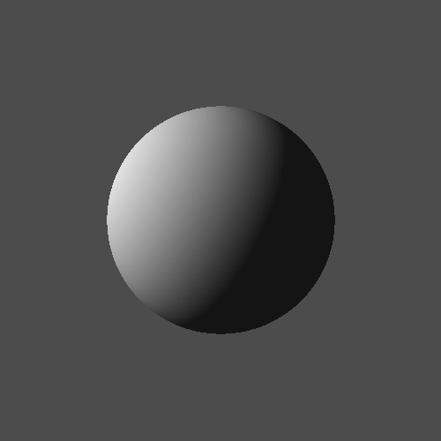
Ambient Shading
Diffuse only
Diffuse + Ambient

Slide 38
Specular Shading
Simulates shiny surfaces
Unlike diffuse shading, specular shading is view-dependent
Several models exist with the most commonly used (and one of the simplest) being Blinn-Phong shading

Slide 39
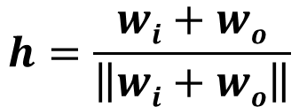
Blinn-Phong (Specular) Shading
Assumes perfect reflection occurs along the mirror direction of the incoming light
But for efficiency, a vector known as the half vector is computed
The angle between the surface normal and the half vector determines the shininess
w_{i}
n
α
h
Θ
$$h=\frac{wi+wo}{\left\|wi+wo\right\|}$$
w_{o}
x

Slide 40
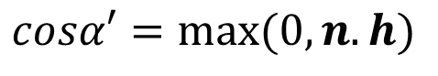
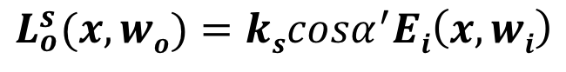
Blinn-Phong (Specular) Shading
w_{i}
n
α
h
Θ
$$L_{o}^{s}(x,wo)=kscosα^{′}Ei\left(x, wi\right)$$
w_{o}
x
Outgoing
radiance
Specular
reflectance
coefficient
Received
irradiance
$$cosα′=max⁡(0, n.h)$$

Slide 41
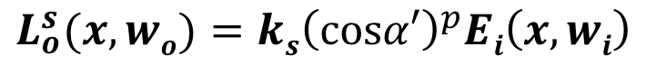
Blinn-Phong (Specular) Shading
To control the shininess, an exponent known as the Phong exponent is introduced:
Phong exponent
w_{i}
n
α
h
Θ
$$L_{o}^{s}(x,wo)={ks\left(cosα′\right)}^{p}Ei\left(x, wi\right)$$
w_{o}
x
Outgoing
radiance
Specular
reflectance
coefficient
Received
irradiance
$$cosα′=max⁡(0, n.h)$$

Slide 42
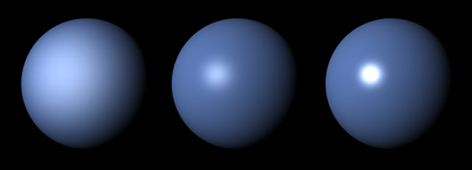
Phong Exponent
Larger Phong exponent makes the highlight more focused, giving the object a shinier appearance
http://cgru.sourceforge.net/

Slide 43
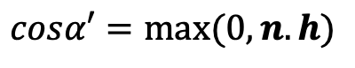
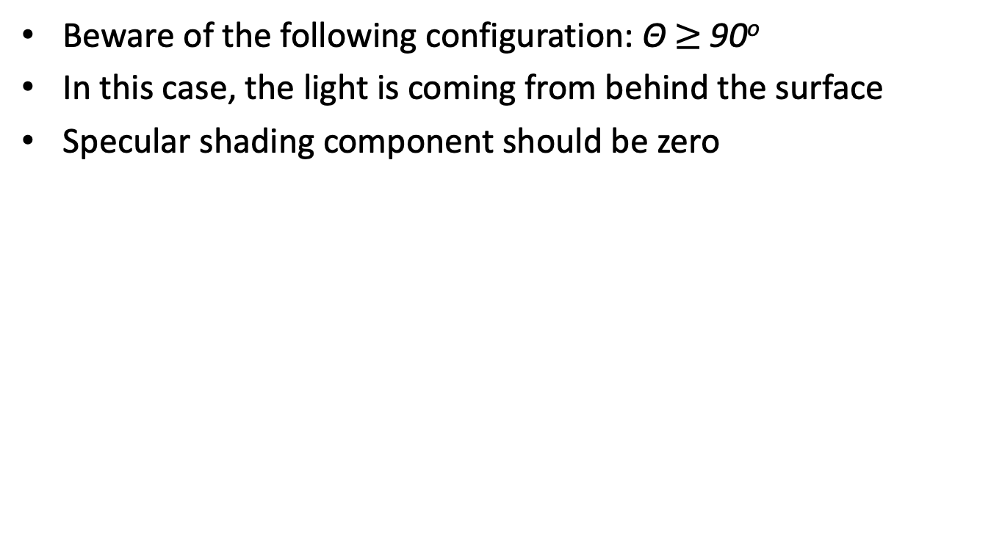
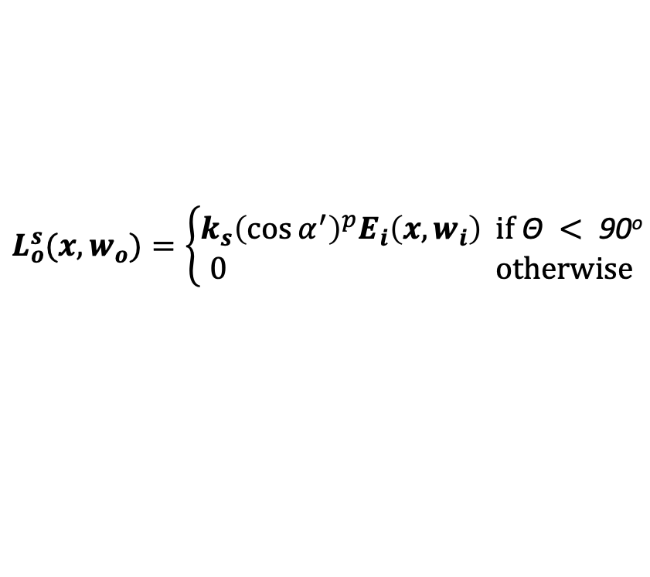
Blinn-Phong (Specular) Shading
Beware of the following configuration: Θ $≥$ 90º
In this case, the light is coming from behind the surface
Specular shading component should be zero
h
n
α
w_{o}
Θ
x
$$L_{o}^{s}(x,w_{o})=\left\{\begin{aligned}k_{s}{\left(\cos{α^{′}}\right)}^{p}E_{i}\left(x, w_{i}\right) \text{if} \text{Θ} <\text{ 90}\text{o} \\ 0 \text{otherwise}\end{aligned}\right.$$
w_{i}
$$cosα′=max⁡(0, n.h)$$

Slide 44

Blinn-Phong (Specular) Shading
Diffuse + Ambient
Diffuse + Ambient + Specular

Slide 45
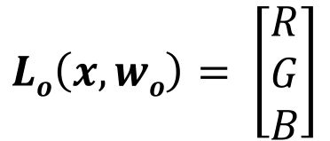
Putting it All Together
The color of an object at any point can be computed by combining diffuse, ambient, and specular components:
Note that L is vector-valued in which each component represents the radiance for each color channel
$${{L_{o}^{}\left(x,wo\right)=L}_{o}^{d}\left(x,wo\right)+L}_{o}^{a}\left(x,wo\right)+L_{o}^{s}(x,wo)$$
$$Lo\left(x, wo\right)= \left[\begin{matrix}R \\ G \\ B\end{matrix}\right]$$

Slide 46
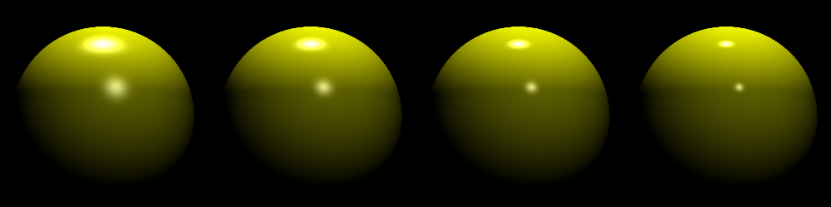
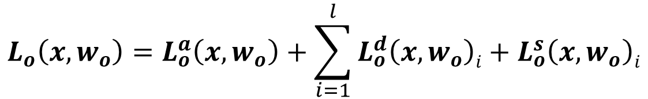
Multiple Light Sources
Diffuse and specular contribution of each light source must be accumulated:
Number of light sources
$$L_{o}\left(x, w_{o}\right)=L_{o}^{a}\left(x,w_{o}\right)+\sum_{i=1}^{l}{L_{o}^{d}\left(x,w_{o}\right)i+L_{o}^{s}\left(x,w_{o}\right)i}$$
L2program.com

Slide 47
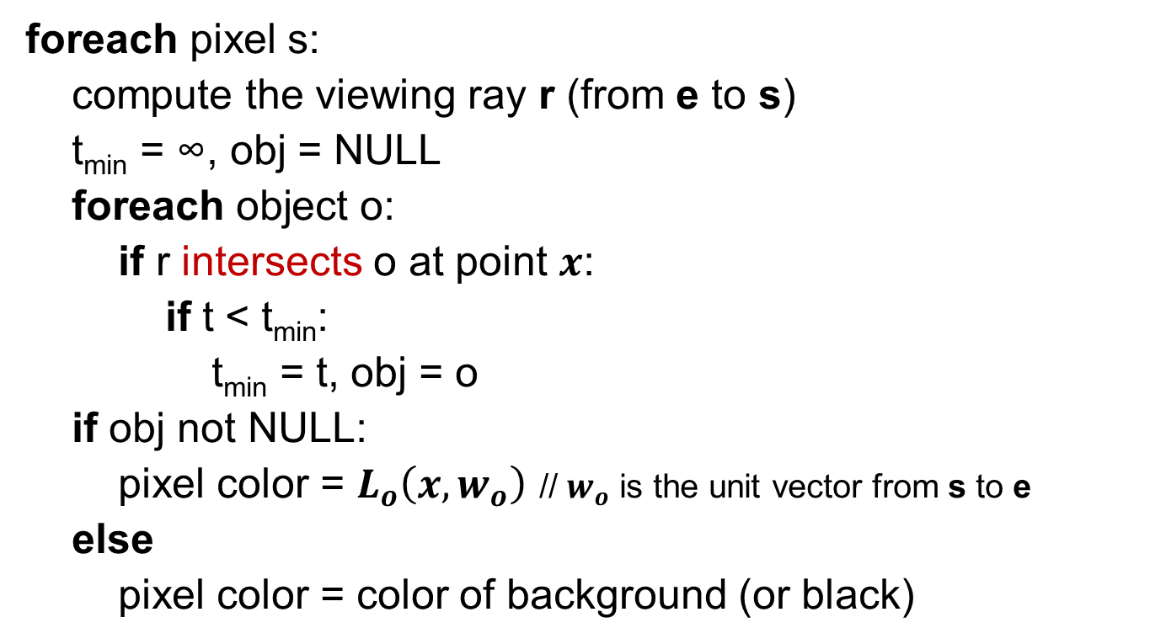
The Ray Tracing Algorithm – So Far
foreach pixel s:
compute the viewing ray r (from e to s)
t_{min} = ∞, obj = NULL
foreach object o:
if r intersects o at point $x$:
if t < t_{min}:
t_{min} = t, obj = o
if obj not NULL:
pixel color = $L_{o}\left(x, w_{o}\right)$ // $w_{o}$ is the unit vector from s to e
else
pixel color = color of background (or black)

Slide 48
Shadows
Shadows can easily be added by checking if the light source is visible from the intersection point
In the configuration below, point x is in shadow:
w_{i}
n
h
Θ
α
w_{o}
x

Slide 49
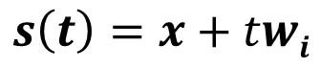
Shadows
To check if the light source is visible from the intersection point, we can create shadow rays, one for each light source
w_{i}
$$s\left(t\right)=x+twi$$
n
h
Θ
α
w_{o}
x

Slide 50
Shadows
Intersect s(t) with all the objects in the scene. If there is no intersection before the light source, the point is not in shadow. Otherwise it is in shadow
$$s\left(t\right)=x+twi$$
w_{i}
n
h
Θ
α
w_{o}
x

Slide 51
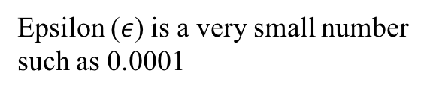
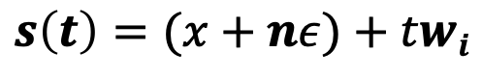
Shadows
To avoid self intersection due to floating point precision problems, the origin is offset by a very small amount:
$$s\left(t\right)=(x+nε)+twi$$
w_{i}
n
h
Θ
α
w_{o}
Epsilon ($ε$) is a very small number
such as 0.0001
x

Slide 52
Shadows
Alternatively you can check for self intersection by comparing the pointers (or IDs) of the objects
w_{i}
n
h
Θ
α
w_{o}
x

Slide 53
The Ray Tracing Algorithm – So Far
foreach pixel s:
compute the viewing ray r (from e to s)
t_{min} = ∞, obj = NULL
foreach object o:
if r intersects o at point x:
if t < t_{min}:
t_{min} = t, obj = o
if obj not NULL: // viewing ray intersected with an object
pixel color = L_{a} // ambient shading is not affected by shadows
foreach light l:
compute the shadow ray s from x to l
foreach object p:
if s intersects p before the light source:
continue the light loop; // point is in shadow – no contribution from this light
pixel color += L_{d} + L_{s} // add diffuse and specular components for this light source
else
pixel color = color of background (or black)
Do not forget clamping the pixel value to [0, 255] range and rounding it to the nearest integer!

Slide 54
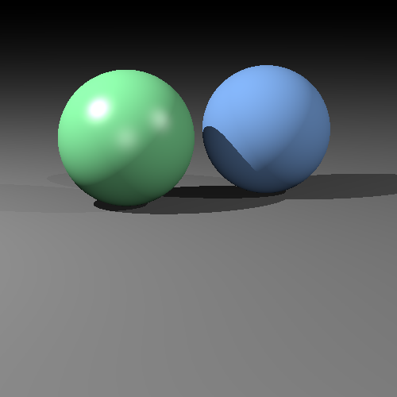
Image So Far
This looks much better! ☺

Slide 55
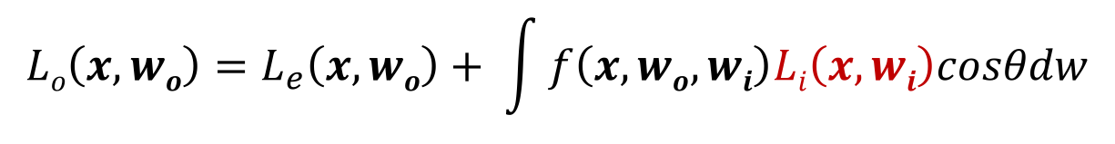
Recursive Ray Tracing
Ray tracing is recursive by nature
Remember the rendering equation
$$Lo\left(x, wo\right)=L_{e}\left(x, wo\right)+ \int{f\left(x, wo, wi\right)Li\left(x, wi\right)cosθdw}$$
This term itself could be due to reflection (or refraction) from another surface

Slide 56
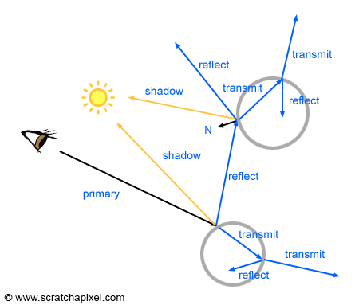
Recursive Ray Tracing
Tracing the incident ray back into the scene (not just directly towards light sources) is called path tracing
This is extremely costly so will only do it for perfect mirrors

Slide 57

Ideal Specular Reflection (Mirrors)
Mirror-like objects reflect colors of other objects
Given w_{o}, we must compute w_{r} (reflection direction)
w_{r}
w_{r} = -w_{o} + 2ncosΘ = -w_{o} + 2n(n.w_{o})
n
Θ
Θ
w_{o}
n, w_{o}, w_{r} are all unit vectors
x
$$L_{o}^{m}(x,wo)=kmLi\left(x, wr\right)$$
Mirror reflection coefficient

Slide 58
Ideal Specular Reflection (Mirrors)
For these surfaces the total radiance is equal to local shading radiance plus the radiance from the mirrored location
w_{r}
n
Θ
Need to stop after a fixed
number of bounces to avoid
potentially infinite recursion
Θ
w_{o}
x
$${{L_{o}^{}\left(x,wo\right)=L}_{o}^{d}\left(x,wo\right)+L}_{o}^{a}\left(x,wo\right)+L_{o}^{s}\left(x,wo\right)+L_{o}^{m}(x,wo)$$

Slide 59
The Recursive Ray Tracing Algorithm
foreach pixel s:
compute the viewing ray r (from e to s)
r.depth = 0 // primary ray
color(s) = clamp(computeColor(r), 0, 255)
computeColor(r):
if r.depth > maxDepth: // max depth exceeded
return (0, 0, 0)
if closestHit(r, hitRecord, scene)):
// find the color at the closest hit point
return applyShading(r, hitRecord)
elif r.depth == 0:
// no intersection for the primary ray
return backgroundColor
else:
// avoid repeated addition of the background color for reflected rays
return (0, 0, 0)
applyShading(r, hitRecord):
material = hitRecord.mat
color = k_{a}L_{a} //start with the ambient light
if isMirror(mat):
// add the color from the mirror direction
reflectionRay = reflect(r.dir, hitRecord.n)
reflectionRay.depth = r.depth + 1
color += computeColor(reflectionRay) * mat.k_{m}
foreach point light l:
if not inShadow(hitRecord.x, l):
// add the diffuse and specular terms
color += diffuseTerm(hitRecord, l) +
specularTerm(hitRecord, l)
return color
hitRecord is a structure that stores important information about the hit point

Slide 60

Final Image
This looks much better! ☺

Slide 61
Ray Tracing
We have only scratched the surface of ray tracing.
There is so much more that can be done:
Acceleration structures
Adding texture
Modeling non-point light sources (area lights)
Refraction (glass-like materials)
Participating media (fog, smoke)
Subsurface scattering (candles)
Complex surface models
Parallel and interactive ray tracing
Ray tracing on the GPU
Photon mapping
Global illumination
Image-based lighting
…

Slide 62

Some Ray-traced Images

Slide 63

Some Ray-traced Images
Physically Based Ray Tracer

Slide 64

Some Ray-traced Images
Physically Based Ray Tracer

Slide 65

Some Ray-traced Images
Physically Based Ray Tracer

Slide 66

Some Ray-traced Images
Radiance Ray Tracer

Slide 67

Some Ray-traced Images
METU Ray Tracer

